Slide 1

Interventions of gcda in the planning and development issues of kochi presented by v. gopalakrishna pillai senior town planner , gcda

Slide 2

How development authorities evolved
LIMITATIONS OF LSGIs PAVED WAY FOR FORMATION OF UDAs
LSGIs COULD ONLY ACT WITHIN THEIR LIMITED JURISDICTION AREA
BUT DEVELOPMENTS OFTEN STARTED HAPPENING OUT SIDE THEIR ADMINISTRATIVE LIMITS
THEY DIDN’T HAVE ENOUGH TECHNICAL EXPERTISE AS WELL FOR SPATIAL PLANNING EXERCISE

Slide 3
How development authorities evolved
ALSO LACKED POWER TO COORDINATE VARIOUS DEPARTMENTS, DEVELOPMENT AGENCIES THAT OPERATE IN THE AREA
NEED FOR FORMULATING LONG RANGE DEVELOPMENT PLANS AND IMPLEMENTING THE PROPOSALS

Slide 4
HISTORY OF PLANNING ORGANISATIONS IN KOCHI
COCHIN TOWN PLANNING TRUST WAS THE FIRST PLANNING BODY CREATED IN 1963 UNDER PROVISIONS OF TOWN PLANNING ACT
CTPT WAS CREATED TO IMPLEMENT THE INTERIM DEVELOPMENT PLAN FOR KOCHI PREPARED BY TOWN PLANNING DEPT.
THE INTERIM DEVELOPMENT PLAN WAS LATER UPDATED AND THE DEVELOPMENT PLAN FOR COCHIN REGION WAS PREPARED
GCDA WAS CONSTITUTED IN 1976 TO IMPLEMENT THIS REGIONAL DEVELOPMENT PLAN
IN 1994 THE ISLAND REGION WAS SEPERATED FROM GCDA AND GIDA WAS CONSTITUTED FOR EFFECTING AN INTEGRATED DEVELOPMENT OF ISLANDS OF KOCHI.

Slide 5
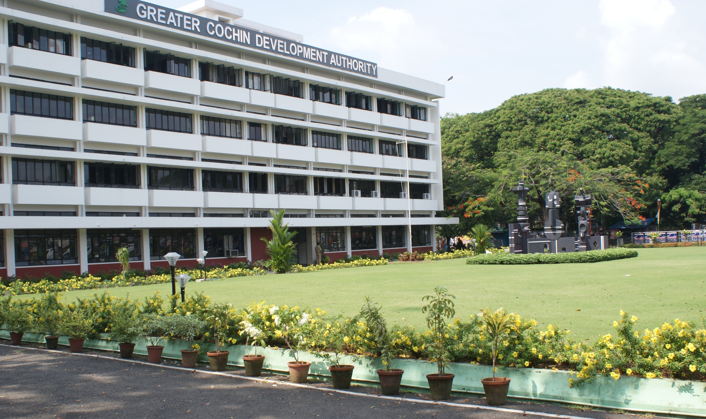
Greater cochin development authority and its activities

Slide 6
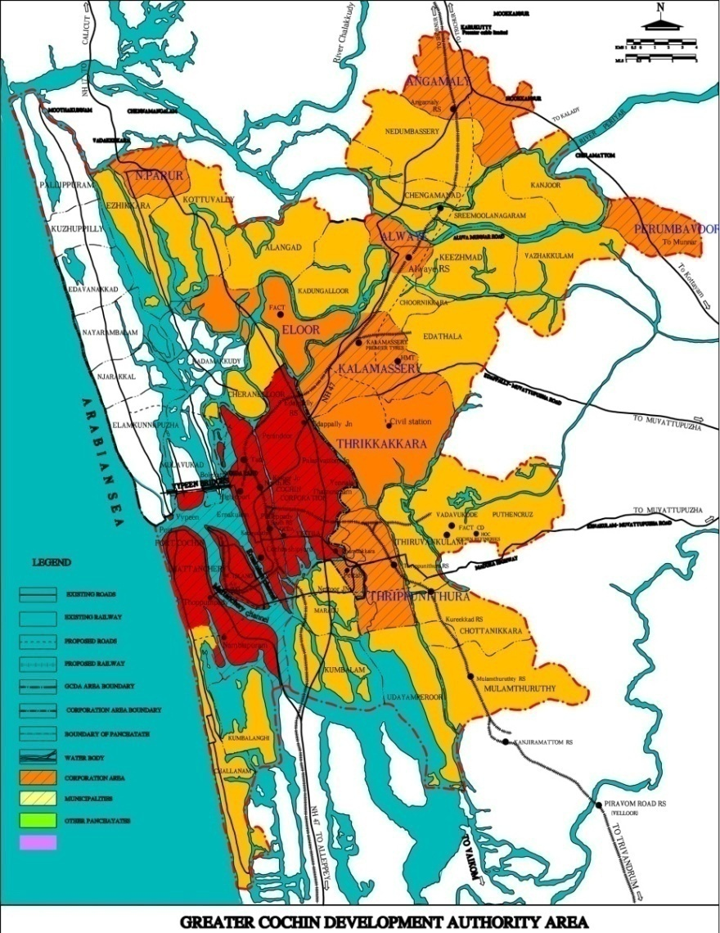
GCDA AREA / GREATER COCHIN REGION
12.1%
9.6%
18.4%
30.2%
POPULATION OF KOCHI METROPOLITAN AREA INCREASED FROM 16.6 LAKHS IN 1991 TO 18.2 LAKHS IN 2001 CENSUS WHICH INDICATES A DECADAL GROWTH RATE OF 9.6%
JURISDICTION AREA
COCHIN CORPORATION,
9 MUNICIPALITIES &
21 PANCHAYATHS

Slide 7
ORGANISATIONAL STRUCTURE OF GCDA
GCDA GENERAL
COUNCIL
GCDA EX.COMMITTEE
CHAIRPERSON
SECRETARY
ADMINISTRATION
DEPT
FINANCE
REVENUE
CELL
PLANNING
ENGINEERING
ESTATE
ESTT &
GENERAL
LEGAL
SECTION
LOAN
REV.CLOSING
CELL
Project /
SCHEMES
FORMULATION
IMPLEMENTATION
ASSETS
MANAGEMENT

Slide 8
PLANNING EFFORTS
STRUCTURE PLAN FOR CENTRAL CITY KOCHI
DETAILED TOWN PLANNING SCHEMES FOR PLAN IMPLEMENTATION
STUDIES ON VARIOUS PLANNING MATTERS OF THE CITY
ASSISTING CONSTITUENT LSGIs FOR PLAN PREPARATION AND IMPLEMENTATION

Slide 9
STRUCTURE PLAN FOR CENTRAL CITY
STRUCTURE PLAN COVERS KOCHI CORPORATION,
4 MUNICIPALITIES AND 5 GRAMA PANCHAYATHS
275 SQ.KM OF AREA IS COVERED BY THE STRUCTURE PLAN
IT ENVISAGE LONG TERM AND SHORT TERM MEASURES FOR THE COMPREHENSIVE DEVELOPMENT OF THE AREA
IT HAS PROPOSED A FUTURE TRANSPORTATION NETWORK AND A LAND USE PLAN
STRUCTURE PLAN PREPARED BY GCDA IS THE PLAN DOCUMENT THAT GUIDE THE PHYSICAL DEVELOPMENTS OF KOCHI CITY TODAY

Slide 10
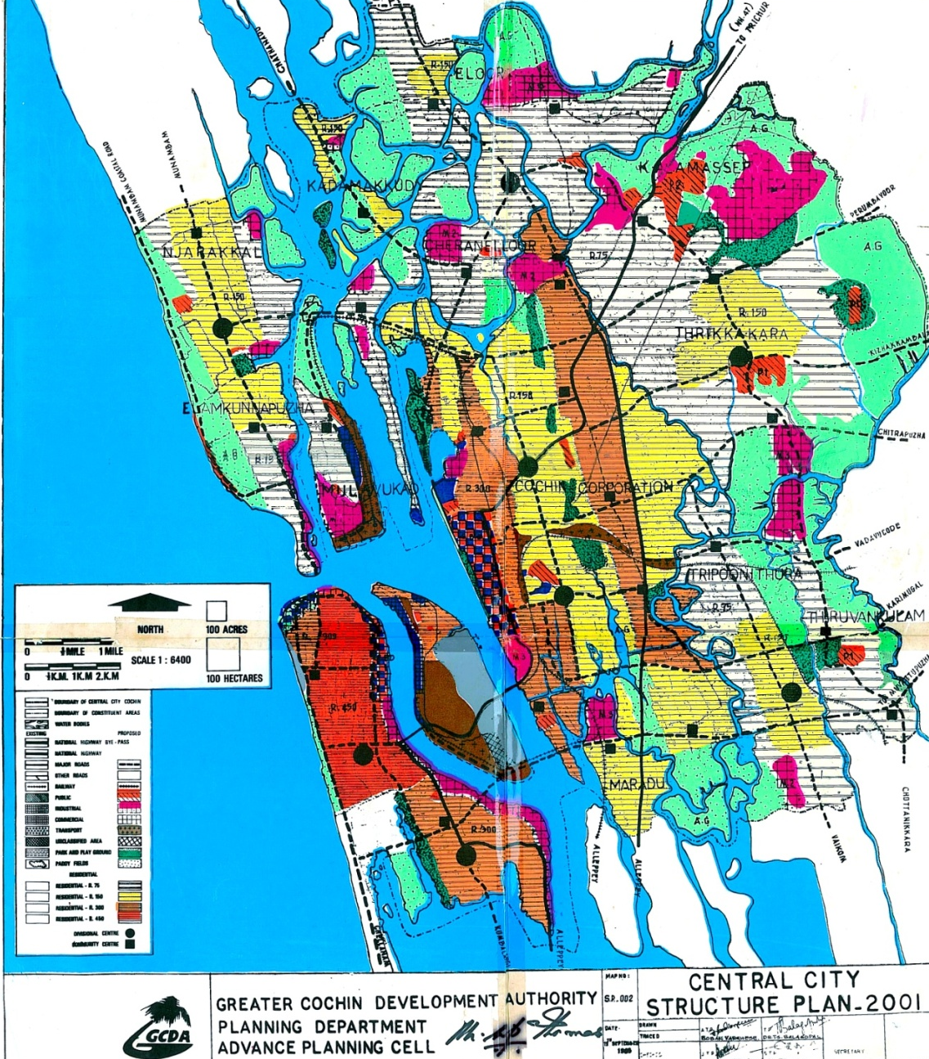
STRUCTURE PLAN

Slide 11
THE AUTHORITY WAS ALSO RESPONSIBLE FOR IMPLEMENTING THE PLAN PROPOSALS
PLAN IMPLEMENTATION BY AUTHORITY HAVE BEEN MADE POSSIBLE THROUGH SPECIFIC PROJECTS AND BY IMPOSING DEVELOPMENT REGULATIONS PUBLIC PRIVATE PARTNERSHIP HAD BEEN ENSURED TO THE EXTENT POSSIBLE IN PROJECT IMPLEMENTATION

Slide 12
PROJECTS WERE IMPLEMENTED IN THE FOLLOWING MAJOR SECTORS
HOUSING
SLUM IMPROVEMENT
ROADS
BRIDGES/FLYOVERS
PARKS AND OPEN SPACES

Slide 13
PROJECTS WERE IMPLEMENTED IN THE FOLLOWING MAJOR SECTORS
STADIA AND PLAY GROUNDS
COMMERCIAL INFRASTRUCTURE
ENVIRONMENTAL IMPROVEMENT
TRANSPORT TERMINALS ETC.

Slide 14
HOUSING TOTAL HOUSES 2787 AND PLOTS 1002
SCHEMES | NO. OF HOUSES | NO. OF PLOTS
PANAMPILLY NAGAR | 656 | 600
GANDHI NAGAR | 1072 | 74
TRIKAKKARA | 225 | 328
COCHIN MARINE DRIVE | 102
KOOVAPADAM | 170
VADUTHALA | 56
KALOOR/T P CANAL | 228
ALUVA | 26
EDATHALA | 202
NORTH PARVUR | 50

Slide 15
Slum Improvement schemes
UDAYA COLONY
KARITHALA COLONY
FORT KOCHI AREA
THAMMANAM KISSAN COLONY
KUTHAPADY COLONY

Slide 16
ROADS IMPLEMENTED IN THE DTP SCHEMES
ELAMKULAM WEST & EXTENSION 14.39 Km
ELAMKULAM NORTH 7.50 Km
KALOOR KADAVANTHRA 3.30 Km
STADIUM BUS STAND 0.50 Km
KALOOR/ TP CANAL 6.40 Km
EKM SOUTH COMM. CENTRE 1.27 Km
KADAVANTHRA WEST 0.95 Km
ELAMKULAM EAST 0.82 Km
RAMESWARAM WEST 6.30 Km
ALUVA THOTTAKATTUKARA 1.50 Km
TRIKAKKARA 6.80 Km
STADIUM LINK ROAD 1.50 Km

Slide 17
BRIDGES / FLYOVERS
MATTANCHERRY BOT BRIDGE
KATHRIKADAVU ROB
RAINBOW BRIDGE – MARINE DRIVE
CHEENAVALAPALAM – MARINE DRIVE
KETTUVALLAM PALAM- MARINE DRIVE
CHILAVANNUR BRIDGE

Slide 18
Park and Open spaces
K T George park 2.50 acres
Changampuzha park 1.60 acres
Aluva Kottarakadavu 1.25 acres
Rajendra maidan 0.80 acres
Marine drive Maidan 5.00 acres
Jawaharlal Nehru stadium 32.00 acres
Ambedkar stadium 8.50 acres
Panampilly Nagar 4.50 acres
Children’s park in front of
GCDA office complex 0.26 ACRES
TOTAL OF ABOUT 60 ACRES

Slide 19
COMMERCIAL INFRASTRUCTURE
MARINE DRIVE SHOPPING COMPLEX
JAWAHARLAL NEHRU STADIUM COMPLEX
PANAMPILLY NAGAR SHOPPING COMPLEX
AMBEDKAR STADIUM COMPLEX
KALOOR MARKET
KADAVANTHRA MARKET
GANDHINAGAR SHOPPING COMPLEX
FORTKOCHI VELI (DHOBI KHANA) ETC.

Slide 20
Environmental Improvement
MARINE DRIVE WALKWAY - 4.00 Km.
T P CANAL IMPROVEMENT- MISSING LINK
AVENUE TREE PLANTATION ALONG MAIN ROADS

Slide 21
Housing Finance
15,000 NOS. OF HOUSING LOANS
SANCTIONED FOR VARIOUS
INCOME GROUPS.

Slide 22
Prestigious Projects
JAWAHARLAL NEHRU INTERNATIONAL STADIUM
PANAMPILLY NAGAR SCHEME
MARINE DRIVE SCHEME
KALOOR - KADAVANTHRA ROAD
MATTANCHERY BRIDGEUNDER BOT
EEC MARKET AT MARADU & MUVATTUPUZHA
EASTERN ENTRY AT ERNAKULAM SOUTH RAILWAY STATION
ASHOKA ,THARANGINI FLATS AND COMMERCIAL COMPLEX AT MARINE DRIVE
GCDA-BLUE DOT JOINT VENTURE RESIDENTIAL APARTMENT AT KADAVANTHARA A PPP PROJECT

Slide 23
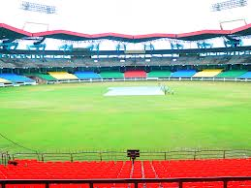
J N I STADIUM

Slide 24
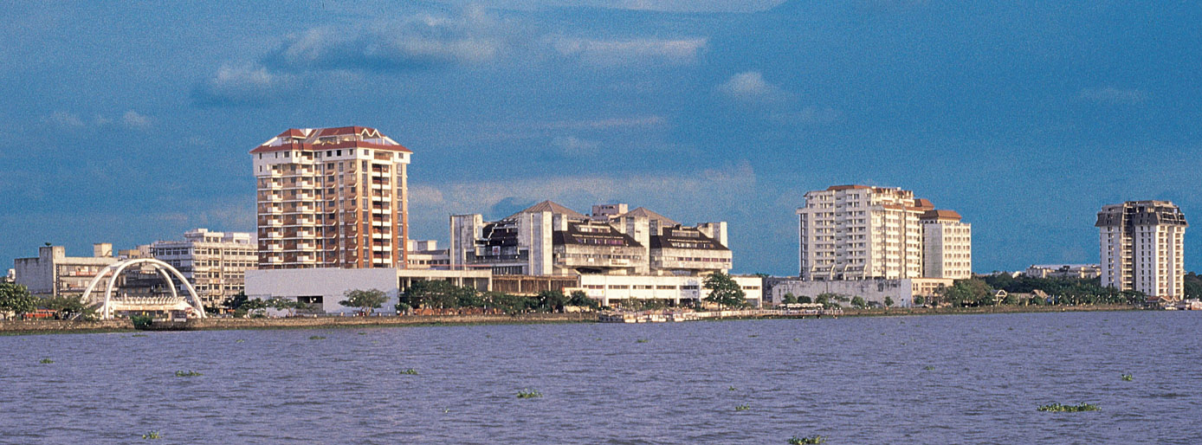
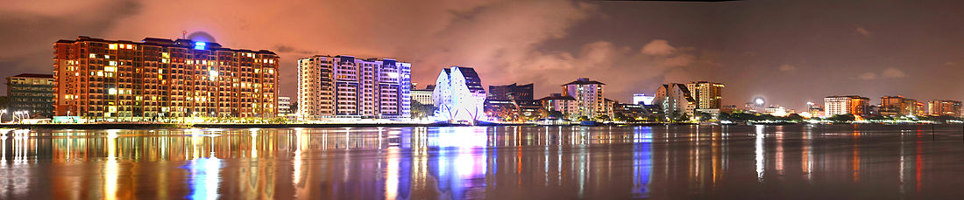
MARINE DRIVE

Slide 25
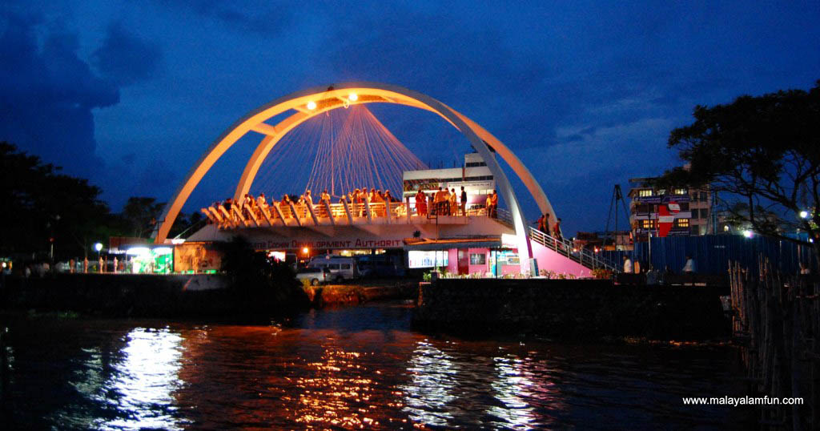
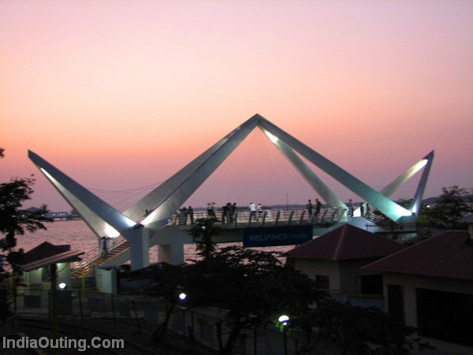
RAINBOW BRIDGE
CHEENAVALA BRIDGE

Slide 26
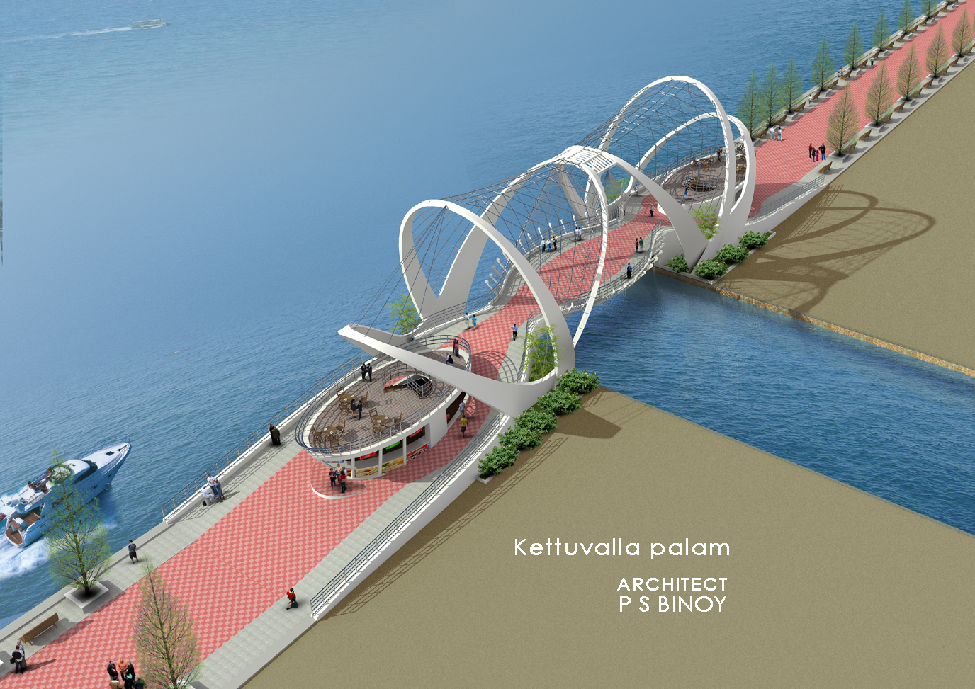
KETTUVALLAM PALAM
AND EXTENSION
OF WALK WAY

Slide 27
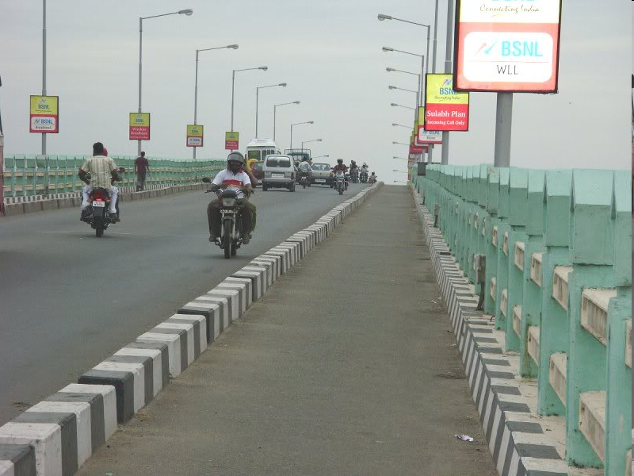
NEW MATTANCHERRY BRIDGE

Slide 28
Ongoing Projects by GCDA
COMMERCIAL INFRASTRUTURE AT MANAPATTYPARAMBU
RAMESWARAM WEST COMPOSITE HOUSING SCHEME
STUDIO APARTMENTS, KAKKANAD
CHILAVANNUR BUND ROAD WIDENING & EXTENSION
AMBEDKAR STADIUM REDEVELOPMENT
PERMANENT EXHIBITION HALL AND CONVENTION CENTER AT JNI STADIUM
DEVELOPMENT OF ENTERTAINMENT CENTRE AT MARINEDRIVE VIZ., LAZER PARK, TETHERED HELIUM BALOON , TUNNEL AQUARIUM , PASSENGER ROPEWAY ETC.

Slide 29
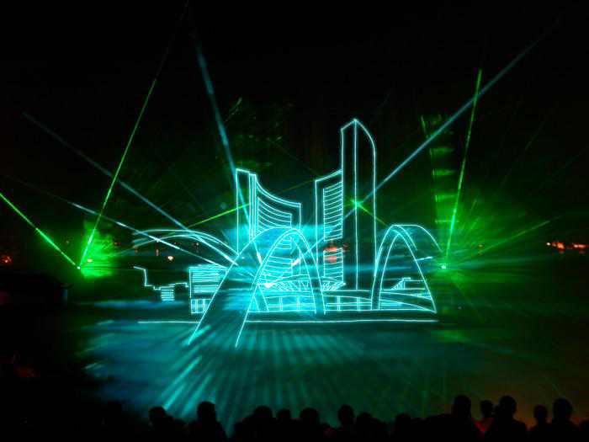

Slide 30
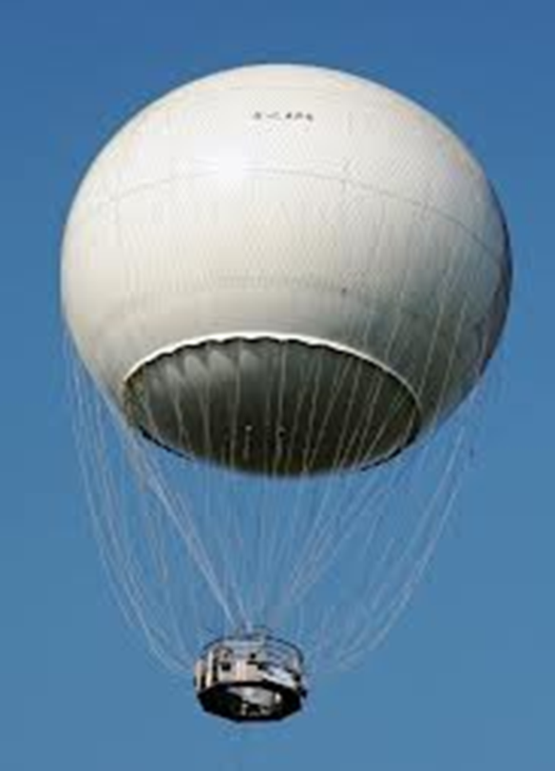

Slide 31
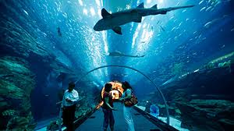

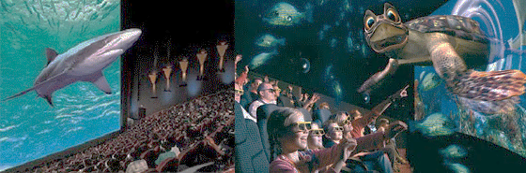
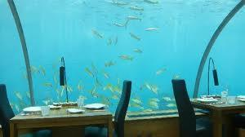

Slide 32
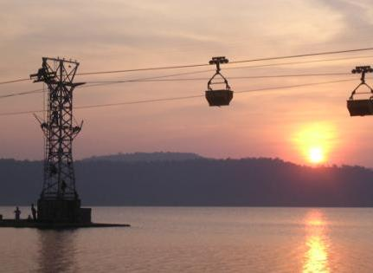

Slide 33
Projects proposed to be undertaken by GCDA
OUTER RING ROAD
SPORTS COMPLEX AT MUNDAMVELI
KOCHI HYGEIA VALLEY- THE HEALTHY CITY PROJECT
SATELLITE TOWNSHIP DEVELOPMENT AT ALANGAD,NEDUMBASERRY,PUTHENCRUZ, CHELLANAM
VENNALA LAND BANK DEVELOPMENT

Slide 34
CHANGED SCENARIO IN THE CONTEXT OF 74TH CAA
UNDER THE 74TH AMENDMENT, TOWN PLANNING IS EXPLICITLY A FUNCTION OF THE ELECTED LOCAL BODY- HENCE ROLE OF DA AS A PLANNING BODY BECOMES QUESTIONABLE
GOVT. ISSUED G.O TO TRANSFER CERTAIN POWERS OF GCDA TO LSGIs
GOVT. ALSO ORDERED TO WIND UP ALL DAs IN THE STATE EXCEPT GCDA, GIDA AND TRIDA.
DESPITE THE 74TH AMENDMENT, GOI HAS NOT WOUND UP THE BIGGEST DA OF ALL , THE DDA
DA s OF OTHER STATES OF THE COUNTRY SUCH AS BMRDA, CMDA, HUDA, BDA ETC. ALSO CONTINUE TO PERFORM THEIR DUTIES EVEN AFTER THE CAA.

Slide 35
SPATIAL PLANNING IN KOCHI AFTER CAA
SINCE POWERS ON TOWN PLANNING WERE TRANSFERRED TO LSGIs, GCDA WAS UNABLE TO PROCEED WITH NEW SPATIAL PLANNING ASSIGNMENTS AND CARRYOUT REVISIONS FOR THE EXISTING PLANS
COC ATTEMPTED TO REVISE THE STRUCTURE PLAN FOR CENTRAL CITY JOINTLY WITH OTHER CONSTITUENT LOCAL BODIES

Slide 36
SPATIAL PLANNING IN KOCHI AFTER CAA
LATER GOVT. ENTRUSTED THE T & CP DEPT. TO REVISE THE STRUCTURE PLAN AND PREPARE A NEW DEVELOPMENT PLAN FOR KOCHI.
THE PREPARATION OF THE DEVELOPMENT PLAN IS IN A PROGRESSING STATE
GOVT. HAVE CONSTITUTED A JTPC TO PUBLISH AND PERFORM OTHER PROCEEDINGS OF THE DEVELOPMENT PLAN.
GCDA HAS NOT BEEN ASSIGNED ANY DUTY OR RESPONSIBILITY IN THE PROCESS OF PREPARING THE DEV. PLAN

Slide 37
SPATIAL PLANNING IN KOCHI AFTER CAA
REGARDING NEW DETAILED PLANNING SCHEME FORMULATION AND IMPLEMENTATION OF DTP SCHEMES NO MUCH EFFORT HAVE BEEN MADE BY THE COC.
LACK OF EXPERTISE IN SPATIAL PLANNING, SHORTAGE OF MAN POWER ETC. COULD BE THE REASON FOR NOT PERFORMING THE DUTIES TRANSFERRED VIDE CAA.

Slide 38
SPATIAL PLANNING IN KOCHI AFTER CAA
THE EXISTING STRUCTURE PLAN FOR KOCHI WHICH IS STILL IN FORCE HAD THE HORIZON YEAR 2001, AND CITY HAD WITNESSED SEVERAL CHANGES SINCE THEN
SOME EXAMPLES LIKE THE ICTT PROJECT AT VALLARPADOM, MASSIVE IT INFRASTRUCTURE DEVELOPMENTS, LARGE SCALE DEVELOPMENTS AT PUTHUVYPIN, METRO RAIL ETC. ARE DEFENITE TO ALTER THE FUTURE CITY SCAPE.
ITS ESSENTIAL TO HAVE A NEW DEVELOPMENT PLAN IMMEDIATELY ACCOMMODATING THE IMPACT OF THESE INVESTMENTS THAT CITY IS WITNESSING.

Slide 39
VIEW ON THE NEW DAs
KERALA MUNICIPALITY ACT 1994 (KMA 1994) ALREADY HAS PROVISIONS FOR THE CONSTITUTION OF METROPOLITAN PLANNING COMMITTEES (MPCS).
MPC SHALL BE CONSTITUTED FOR KOCHI METROPOLITAN AREA AS PER THE PROVISIONS IN THE KMA 1994.
THE MPC WILL BE THE AGENCY RESPONSIBLE FOR PREPARING THE DRAFT DEVELOPMENT PLAN FOR THE METROPOLITAN AREA.

Slide 40
VIEW ON THE NEW DAs
ELEVATE GCDA TO KMRDA AND NOTIFY IT’S NEW AREA OF JURISDICTION INCLUDING GIDA AREA AND DEFINE FUNCTIONS
KMRDA SHALL BE MADE AS THE TECHNICAL SECRETARIAT OF THE MPC
KMRDA SHOULD BE MANDATED TO IMPLEMENT LARGE SCALE PROJECTS AND CENTRALLY SPONSORED PROJECTS IN THE REGION . RESPONSIBILITY OF IMPLEMENTING SMALLER PROJECTS SHOULD BE VESTED WITH LSGIs THEMSELVES AS ENVISAGED IN THE 73RD AND 74TH CAA , KPR ACT 1994 AND THE KMA 1994.

Slide 41
VIEW ON THE NEW DAs
MAKING KMRDA THE TECHNICAL ARM OF THE MPC WOULD RETAIN THE CONSTITUTIONALITY AND ALSO ENABLE THE GOK TO BOOST INFRASTRUCTURE INVESTMENT IN THIS REGION AND PROMOTE PROACTIVE PLANNING RATHER THAN PAPER PLANNING AND REACTIVE INVESTMENTS.

Slide 42
VIEW ON THE NEW DAs
KMRDA MUST BE MADE THE NODAL AGENCY RESPONSIBLE IN IMPLEMENTING NEW DEVELOPMENT TOOLS SUCH AS TDR, ACCOMMODATION RESERVATION, LAND POOLING/RE-CONSTITUTION ETC.

Slide 43
ACTIONS NEEDED
CONSTITUTE THE KMPC
ELEVATE GCDA TO KMRDA AND NOTIFY IT’S NEW AREA OF JURISDICTION AND FUNCTIONS
CONSTITUTE THE GENERAL COUNCIL/EXECUTIVE COMMITTEE OF KMRDA
FRAME THE KMRDA RULES

Slide 44
ACTIONS NEEDED
2011 CENSUS HAS REVEALED THAT KOLLAM, THIRUVANATHAPURAM , THRISSUR AND KOZHIKODE ARE MILLION PLUS UAs
HENCE OTHER EXISTING DA s IN THE STATE ALSO SHALL BE ELEVATED TO THE STATUS OF REGIONAL METROPOLITAN DEVELOPMENT AUTHORITIES IN THE MANNER STATED AS ABOVE.

Slide 45
THE NEW ORDINANCE IN PLACE OF THE TP ACT SAYS..
THE DEVELOPMENT AUTHORITIES CONSTITUTED UNDER THE REPEALED ACT CONTINUE IN OFFICE TILL SUCH TIME AS THE GOVERNMENT MAY BY NOTIFICATION , IN THE OFFICIAL GAZETTE, ORDER THAT THE DA CONCERNED SHALL CEASE TO EXIST FROM THE DATE THAT MAY BE SPECIFIED IN SUCH NOTIFICATION…

Slide 46
THE NEW ORDINANCE IN PLACE OF THE TP ACT SAYS..
….UNTIL A DA CEASED TO FUNCTION AS ABOVE IT SHALL EXERCISE THE POWERS AND PERFORM THE FUNCTION VESTED IN IT UNDER THE REPEALED ACT AS IF THE SAID ACT ARE STILL IN FORCE SUBJECT TO THE RULES MADE UNDER THE SAID ACT AND SUBJECT TO THE TERMS AND CONDITION AS MAY BE DECIDED BY THE GOVT. FROM TIME TO TIME AND ITS ASSETS AND LIABILITIES SHALL REMAIN WITH IT AND ITS OFFICERS AND EMPLOYEES SHALL REMAIN IN ITS SERVICE

Slide 47
THANK YOU

Slide 48
COMMERCIAL INFRASTRUTURE AT MANAPATTYPARAMBU
World class commercial infrastructure at Manapattiparambu on BSOT basis.
Land area- 270 acres
Built up area – 4.5 lakh sq.ft
Cost – 175 crores
Facilities
Word class shopping facility
Entertainment zone
Food court

Slide 49
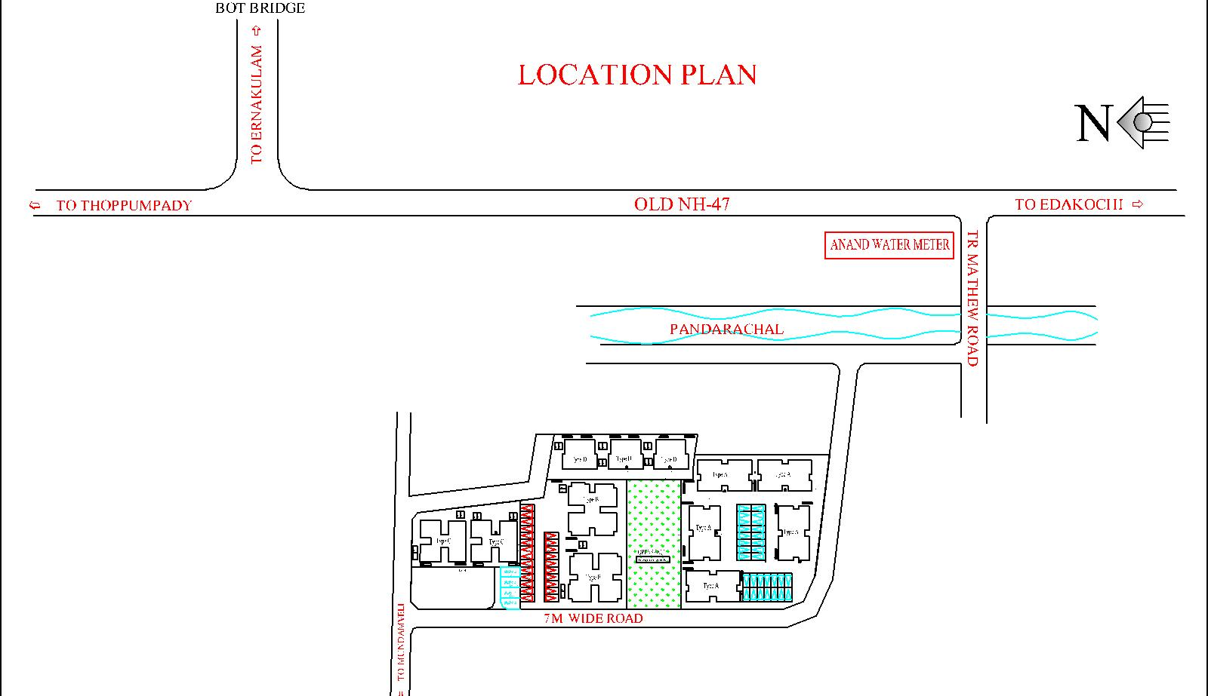
RAMESWARAM WEST HOUSING SCHEME
TYPE - A 108.38 SQM/D UNIT
TYPE - B 73.58 SQM/D UNIT
TYPE - C 54.40 SQM/D UNIT
TYPE - D 32.48 SQM/D UNIT
TYPE – A 5 BLOCKS 30 UNITS
TYPE – B 2 BLOCKS 24 UNITS
TYPE – C 2 BLOCKS 24 UNITS
TYPE - D 3 BLOCKS 36 UNITS
PROJECT AREA - 89.18 ARES

Slide 50
STUDIO APARTEMENTS
VILLAGE - KAKKANAD
EXTENT - 6.86ARES
NO OF FLOORS - G+5 FLOORS
NO OF UNITS - 25
NATURE OF UNIT- ONE BED ROOM UNIT
PLINTH AREA OF 1 UNIT- 31.50SQM
TOTAL PLINTH AREA - 1195.25SQM

Slide 51
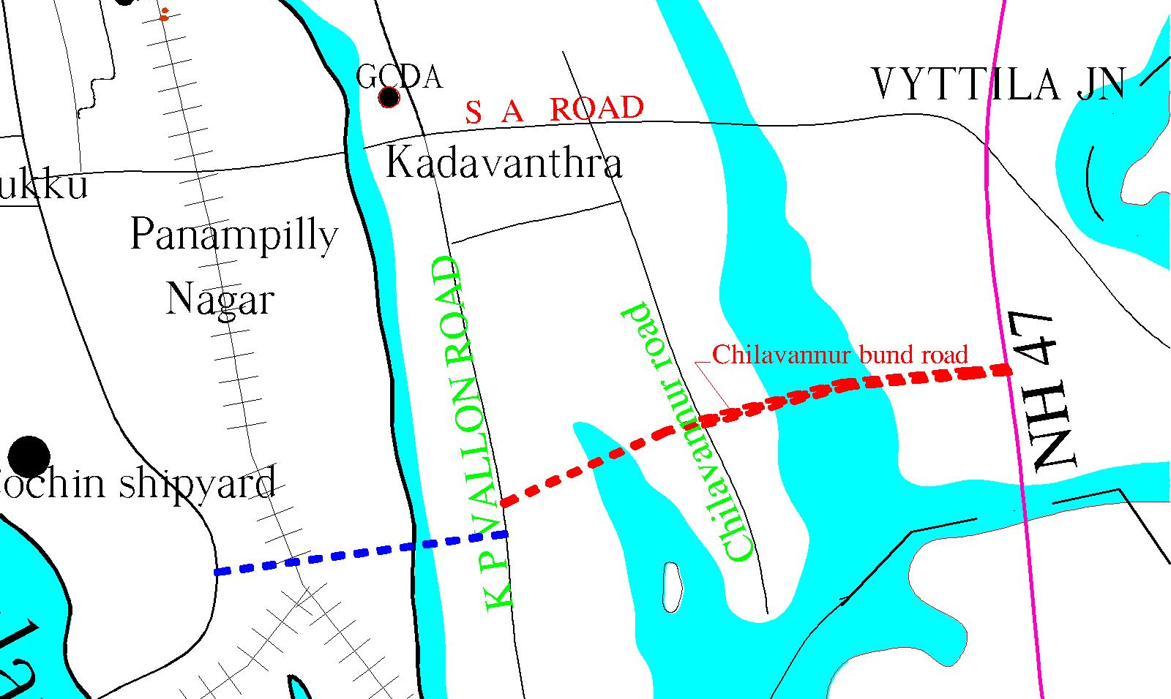
CHILAVANNUR BUND ROAD
ROAD PARALLEL TO S A ROAD LINKING NH BYPASS AND K.P VALLON ROAD .
NH 47 BYEPASS TO K.P. VALLON ROAD -TOTAL LENGTH -1.5KM
15 M WIDE ROAD FROM NH 47 BYEPASS TO CHILAVANNUR ROAD
10 M WIDE ROAD FROM CHILAVANNUR ROAD TO K.P. VALLON ROAD

Slide 52
AMBEDKAR STADIUM REDEVELOPMENT
The project aim at developing a new stadium after demolishing the existing one jointly with the KFA
GCDA have signed an MOU with KFA
The new stadium will have 10,000 seating capacity and artificially turfed play field.
The player’s facilities in the stadium will be of FIFA standard
Parking for about 600 cars will be provided as underground.

Slide 53
PERMANENT EXHIBITION HALL AND CONVENTION CENTER AT JNI STADIUM
The project aim is to develop a world class exhibition cum convention centre for the city
About 7 acres of land is earmarked in front of the JNI stadium for this project
The facility will have a total built up area of 2.8 lakh sqft.
The saleable area of the centre will be 80,000 sq.ft with flexibility to use in multiple units
Food courts , meeting halls etc. are provided as allied facilities

Slide 54
Multimedia entertainment centre at rajendra maidan
The multimedia entertainment centre comprise of colour laser show system integrated with video projection on aqua screen, intelligent lighting, audio and musical fountain
The laser show will be exhibited by theme with laser animation equipments and water jet fountains synchronised with music
The project will be implemented on turn key basis.

Slide 55
Tethered helium balloon
The aim is to introduce a modern recreational facility viz. Tethered helium balloon at marine drive ground to enjoy a panoramic view of the city
The project will be implemented on PPP mode
The partner firm shall install the Tethered helium balloon of certified capacity of 30
Operate and maintain it for 20 years from COD and transfer the facility back to GCDA.

Slide 56
Tunnel aquarium
This is a modern recreational facility to view the replica of the natural habitat under sea and gain awareness about marine environment
The project will be implemented on PPP mode
The infrastructure will have
Tunnel marine aquarium
Marine fish aquarium
Research and seminar centre
7d Theatre
Under watEr restaurant
Childrens play area etc.

Slide 57
PASSENGER ROPEWAY
PASSENGER ROPEWAY WOULD GIVE AN OPPURTUNITY TO ENJOY A PANORAMIC VIEW OF BACKWATERS AND SURROUNDINGS.
PROJECT IMPLEMENTED ON PPP BASIS
LOCATION – 1.5 KM DISTANCE OVER BACKWATERS ALONG SIDE OF MARINE DRIVE WALKWAY.
The authority is in the process of inviting EOI for these projects

Slide 58
OUTER RING ROAD
The proposal by GCDA is for a 64 km long 6 lane ring road for Kochi.
The project is proposed to be implemented in four phases; the first phase is between the GIDA land and NH 17 (Varapuzha), 2nd phase linking NH17 and NH 47 ( Athani), 3rd phase the stretch between NH47 and NH 49 (Puthencruz) and the final phase being the stretch between Puthencruz and Madavana near Aroor in NH47.
14 panchayaths in GCDA jurisdiction will be benefited out of this project.

Slide 59
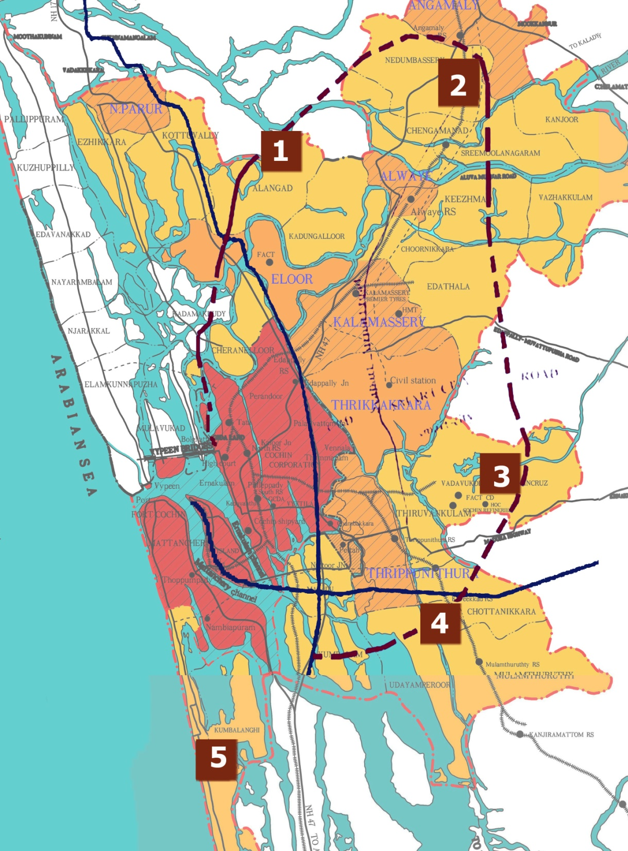
OUTER RING ROAD ALIGNMENT
ALANGAD
NEDUMBASERRY
PUTHEN CRUZE
KUREEKAD
CHELLANAM

Slide 60
OUTER RING ROAD
1ST PHASE–MARINE DRIVE TO NH 17
ALIGNMENT
The proposed road passes through the following locations
Chathiath
Vaduthala
Cheranelloor
Kothad
Chennoor
Thundathumkadavu
Varappuzha
Width of the Ring Road in the first phase is 36m.

Slide 61
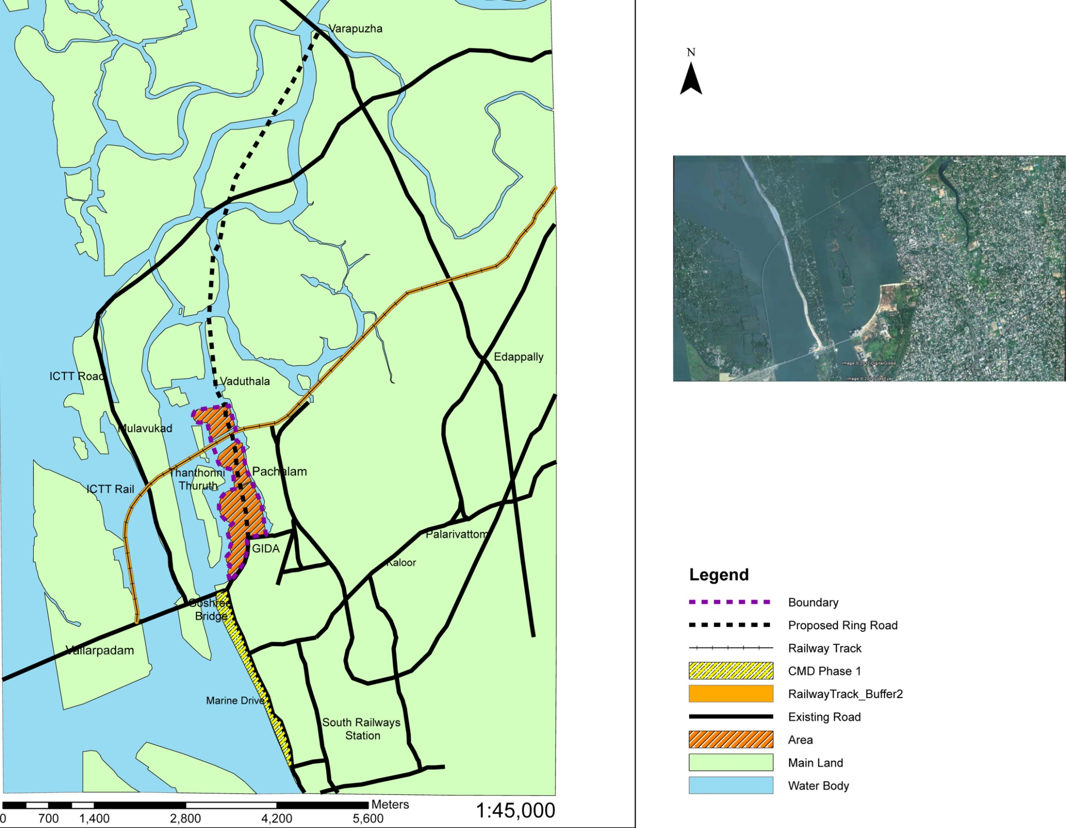

Slide 62
OUTER RING ROAD
PRESENT STATUS
The project had been presented before the Coastal Zone management Authority, CZMA for their approval and a conditional approval was received from the CZMA.
The cost of the project including land acquisition, rehabilitation, construction of road, other infrastructure etc. is estimated to be 500 Cr.

Slide 63
SPORTS COMPLEX AT MUNDAMVELY
PROPOSAL IS TO CREATE A SUSTANABLE INTEGRATED SPORTING INFRA STRUCTURE ON PPP BASIS.
THE SITE IS LOCATED ALONG THE SIDE OF PANDARACHIRA THODU COMPRISING AN AREA OF 4.5 ACRES.
THE FACILITIES ENVISAGED ARE:
BADMINTON COURT
SQUASH COURT
TABLE TENNIS
BOXING
JUDO
SHOOTING RANGE
SWIMMMING POOL
VOLLEY BALL
TENNIS
WRESTLING MATS

Slide 64
HEALTH CITY – KUREEKAD
Proposal is for the development of a satellite township at kureekad near Tripunithura having an extent of 300 hects. The project is proposed to be placed under the satellite township development programme of Govt. of India
PROJECT DETAILS
Development of residential ,tourism , commercial and open space with necessary infrastructure network.
Area identified for development at present is 101 hects in the 1st phase. The entire land need be acquired and developed .
Project cost – 207 crores.(approx.)

Slide 65
ROAD LINKING KARSHAKA ROAD AND K K ROAD
Proposal is for linking South Railway Station Eastern Entry with NH 47 Bypass
Width of road – 16 m (South Railway Station to SC Bose road)
Road portion in CALTEX land – 107cent (to be acquired)
CALTEX land - 60 cent
GCDA land - 20 cents
Total - 80 cents

Slide 66
SATELLITE TOWNS
ALANGAD,ELECTRONIC HARDWARE
NEDUMBASSERRY,TOURISM
PUTHENCRUZ ,KNOWLEDGE CITY
KUREEKADU,MEDICAL TOURISM

Slide 67
GREATER COCHIN DEVELOPMENT AUTHORITY
GCDA was constituted in the year 1976 under Town Planning Act
The objective of this authority was to mastermind and coordinate the Integrated Development of Cochin Region.
23 Detailed Town Planning schemes have been published by GCDA and sanctioned by Government
Structure Plan for Central City Kochi prepared and published by GCDA have been sanctioned by Government.
Department of Town & Country Planning has revised the Zoning regulation of Structure plan vide G O (ms.) no. 143/07/LSGD
Master plan for Kochi city region is under preparation by Town & Country Planning dept.

